Slide 1
Basic Network and Troubleshooting
By: nikki c. gonzales

Slide 2
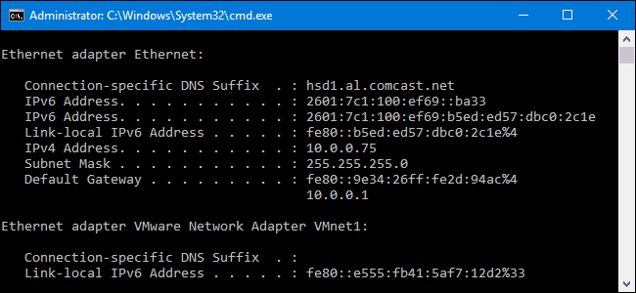
IPCONFIG:
It is commonly used to check the IP(Internet Protocol) configuration value’s.
It commonly displays network configurations such as TCP/IP DNS settings ,Subnet masks, and gateways etc..

Slide 3
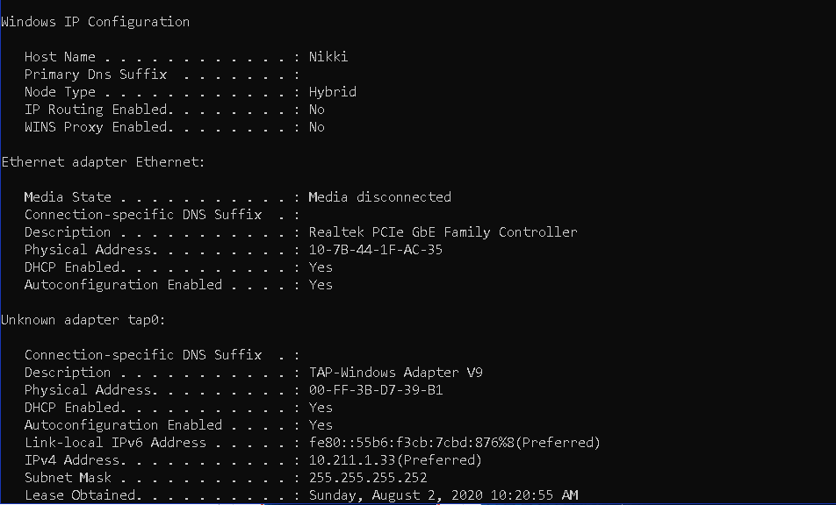
Hostname:
This part in the ipconfig is generally your computer name.
The hostname is configurable when we set up our profile in our computer. This is also the name that other machines can see when they see the architecture of our network.

Slide 4
Connection Specific DNS Suffix:
This is the type of name that is appended in our system if ever we were remote or SSH our computer. This is the name that will help for the lookup in our network. If only our computer is connected to a given server. Then only it will be given by the DHCP server to us.
Ex:
DNS Suffix: mycomputer.com
Host name: Nikki
Full DNS name: Nikki.mycomputer.com

Slide 5
Description:
This is the description or simply the name of our Network Adapter.

Slide 6
Physical Address:
This is the MAC Address which helps the DHCP server to give us a specific and unique IP Address.
MAC Address/ Physical Address is the numerical identity of our computer Hardware Directly configured by the NIC manufacturer.

Slide 7
DHCP Enabled
This tells us if our DHCP is on or off. If its on our IP is provided automatically by the DHCP Server else its all manual/static IP Addresses.

Slide 8
IP Address
This shows our Private Internet Protocol Address. Given to us by the ISP. It can be Static or Dynamic IP Address depending if DHCP is enabled or not.

Slide 9
Subnet Mask
This is used especially if we want to communicate two local machines on the same network to identify which is which. Subnet mask typically masks the network into smaller scale depending on its given range. So that computer will know if the IP address exist or not in the same router.

Slide 10
Default Gateway
This is the IP Address of the router or Modem that’s used in receiving or distributing internet data across all devices.

